Slide 1
The HESS Collective Program ASSIST Community
A community of private colleges & universities working together in Oracle Cloud implementation, support, operations, and innovation.

Slide 2
The HESS Collective Community
A comprehensive, community-driven approach to implementation, operations, support and innovation around a common, cloud-native administrative enterprise system, Oracle Cloud.
Led by HESS private, non-profit colleges and universities
Supported by proven, world-class partners, Oracle & Drivestream
Coordinated by the largest technology consortium created specifically for private, non-profit colleges and universities The HESS Consortium – www.hessconsortium.org

Slide 3
The HESS Collective Value Proposition
HESS Collective Members work together to answer these questions:
How can the efforts of all members take advantage of and contribute to the success of other members?
How can the success of each member be supported by those who have implemented before them?
How can the contributions of later members be cycled back to those institutions that have gone before?
How can a single implementation partner (Drivestream) empower the collective success of all members?

Slide 4
The HESS Collective Activities (current)
The community shares experience and resources through:
Weekly and bi-weekly cohort meetings with Drivestream expertise embedded to share experiences and inspiration.
Special events for implementing schools as well as those planning to migrate to Oracle Cloud through the program
The HESS Collective ASSIST Community Discussion System to post questions, answers, resources and innovations through a “facebook-like” interface.

Slide 5
The HESS Collective Cohort Meetings
The community works in implementation weekly and bi-weekly cohort groups (with Drivestream support staff embedded):
Chief Information Officers and their staff leadership (technical and project management or PM and support)
Chief Financial Officers and their staff leadership (financial focus, functional management, departmental PM)
Chief Human Resource Officers and their staff leadership (HR focus, functional management, departmental PM)
Soon Registrars and Deans and their staff leadership (student system focus, functional management, departmental PM)

Slide 6
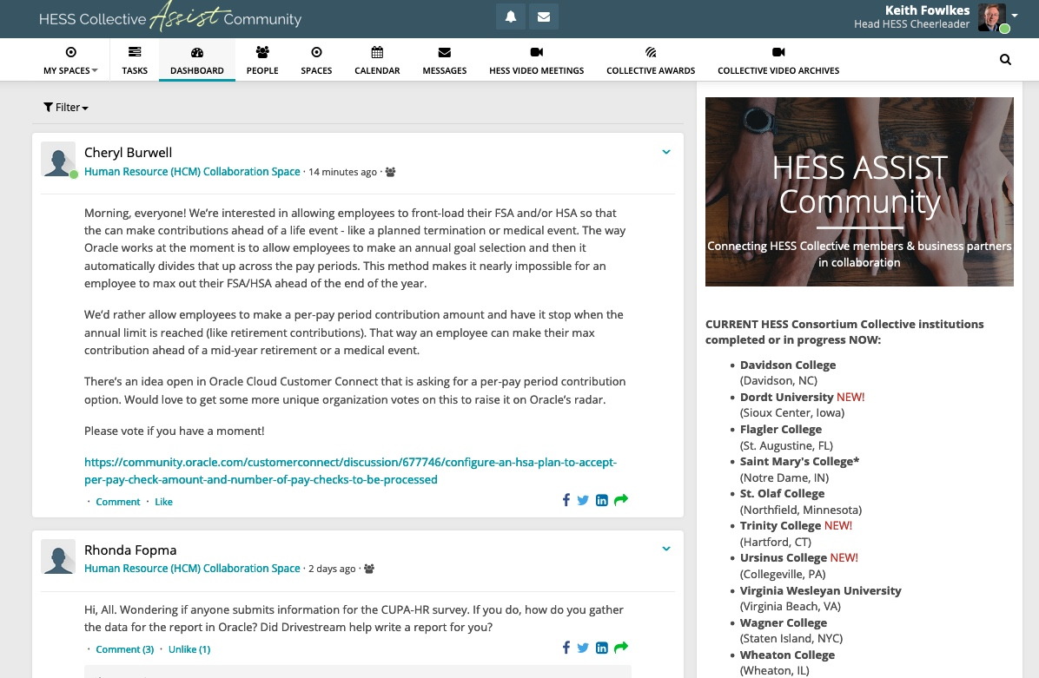
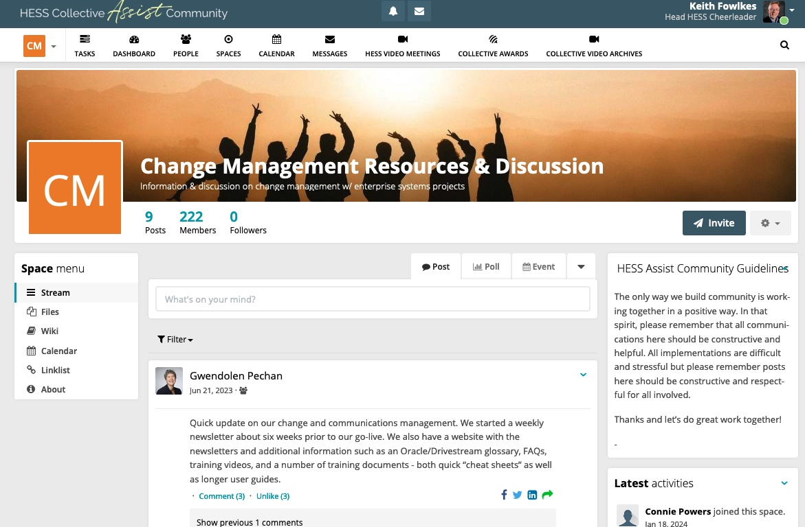
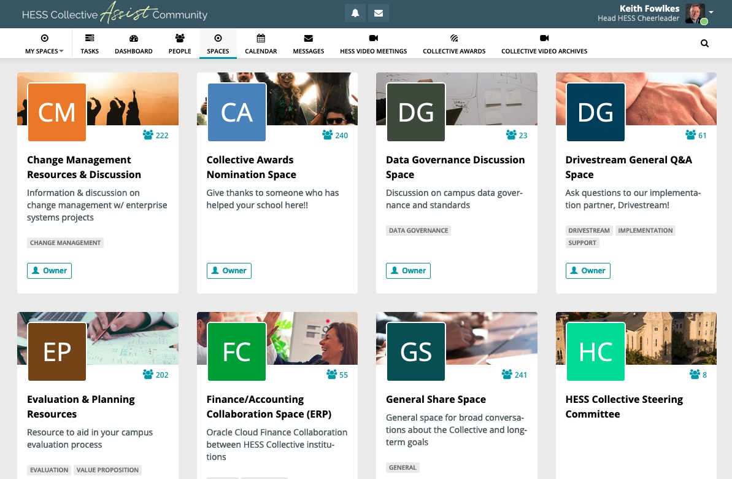
The HESS Collective ASSIST Site (closed membership discussion system)

Slide 7
The HESS Collective Promise
Through our Collective Program efforts:
The use of a single implementation partner drives useful standardization & best-practices when appropriate.
The use of Oracle Cloud Suite software delivers modern, cloud-native software tools that are best-in-class far into the future.
Through ongoing collaborative efforts, our members are solving common problems and inspiring each other with new ideas and approaches.
We are changing the way that Higher Education acquires and implements cost-effective modern enterprise systems that will enable financial and operational sustainability for small private institutions.

Slide 8
Full Program Information at www.hessconsortium.org/collective
A community of private colleges & universities working together in Oracle Cloud implementation, support, operations, and innovation.

