Slide 1
ENA Cloud Services

Slide 2
ENA’s Suite of Enhanced Technology Solutions

Slide 3
Cloud Solutions

Slide 4
ENA Cloud Services Portfolio
Backup-as-a-Service
File backup with cloud storage repository for cost effective protection against data loss
Cloud storage service
Object storage accessible via web interface or an S3 compliant API
Cost-effective storage solution for offsite backups, content hosting, or media streaming
Infrastructure-as-a-Service
Simplified cloud computing designed for everyone

Slide 5
Cloud Management Boundaries
Middleware & Applications
Security
Operational / Administrative
Operating System Software
Customer Managed
Infrastructure as a Service
ENA Managed
Virtualization Software
Network Hardware
Storage Hardware
Server Hardware
Virtual Private Cloud w/ Private Network Connection
Power & Cooling w/ Redundant Systems
Racks & Cable
Data Center Floor Space

Slide 6
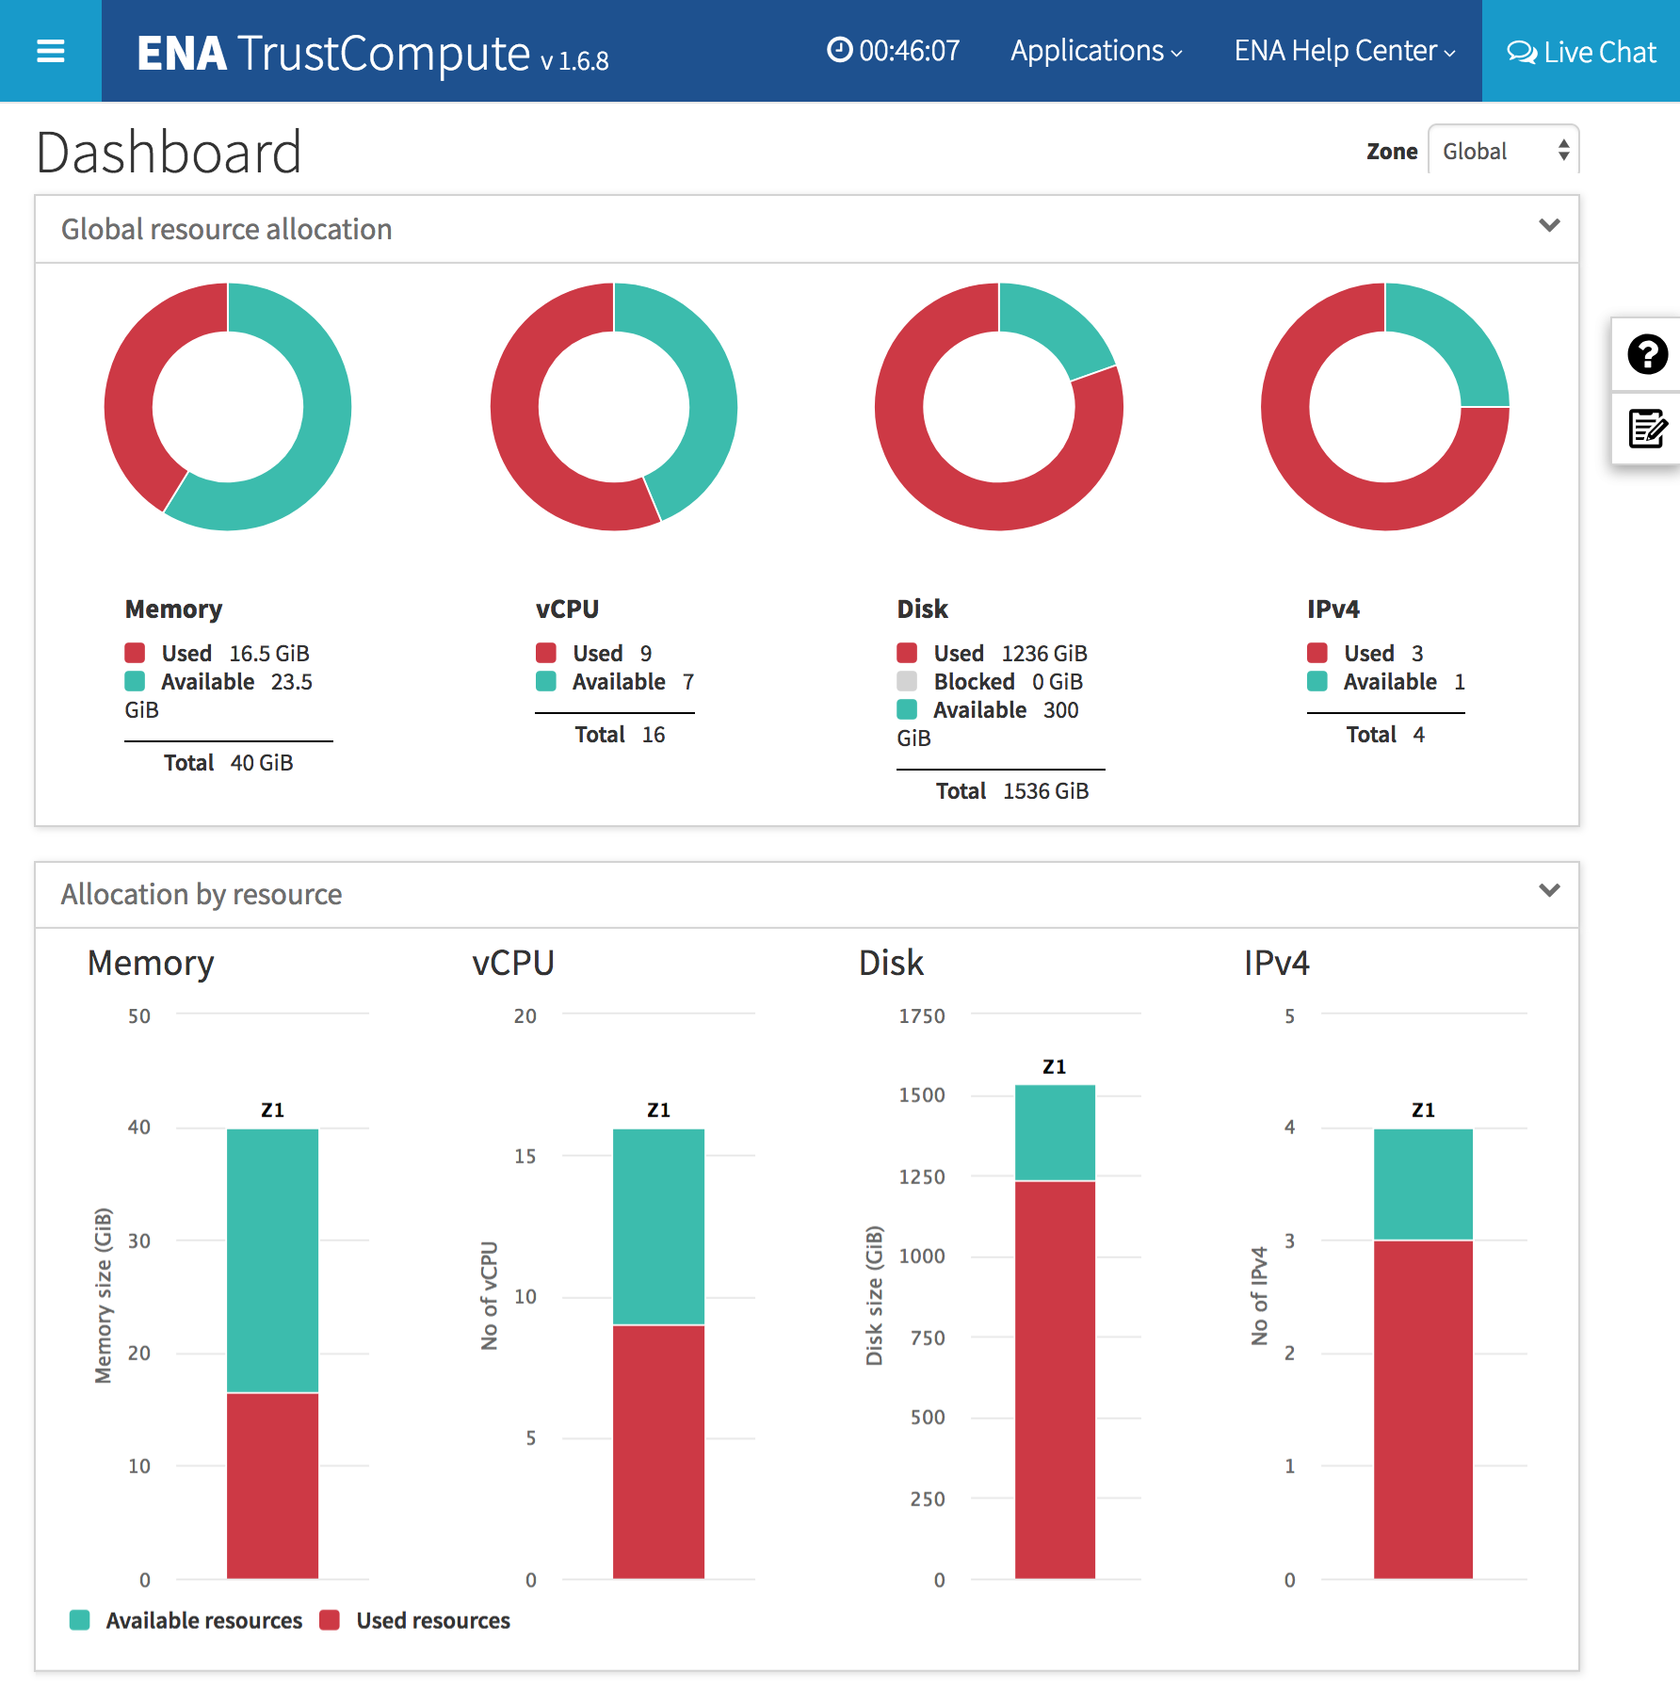
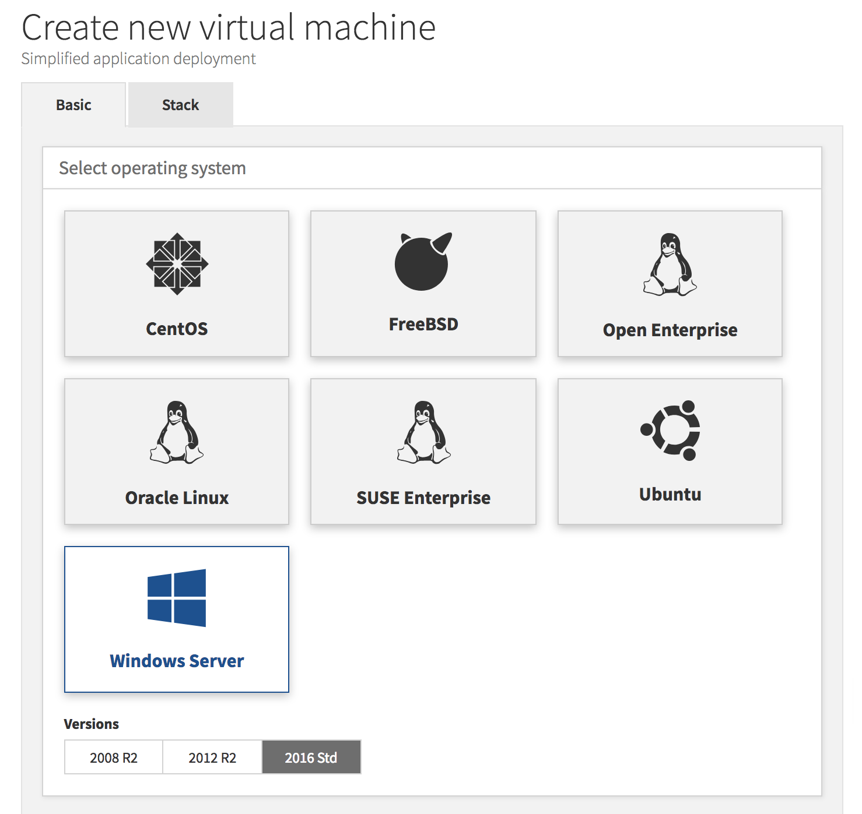
Infrastructure-as-a-Service
Highlights
Virtual private cloud
Inclusive packaging
Multi-region data center option
Advanced networking features
Choice of operating systems
Selection of pre-configured open source application stacks
5-Step VM migration process powered by Veeam

Slide 7
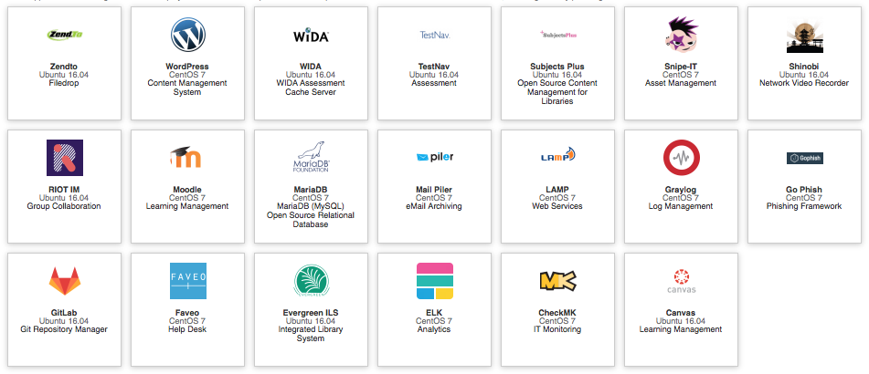
NEW FEATURE: STACKS
Our growing selection of pre-configured, free application stacks saves organizations time and money.

Slide 8
NEW FEATURE: VM Migration
ENA TrustCompute’s guided 5-step migration process helps streamline and simplify VM migration
Step 4
5-Step
VM Migration
Backup Source VM
Activate Migration
Step 1
Download
Migration Director
Step 2
Install
Agent
Step
5
Restore VM
in ENA TrustCompute
Step
3
Powered by Veeam

Slide 9
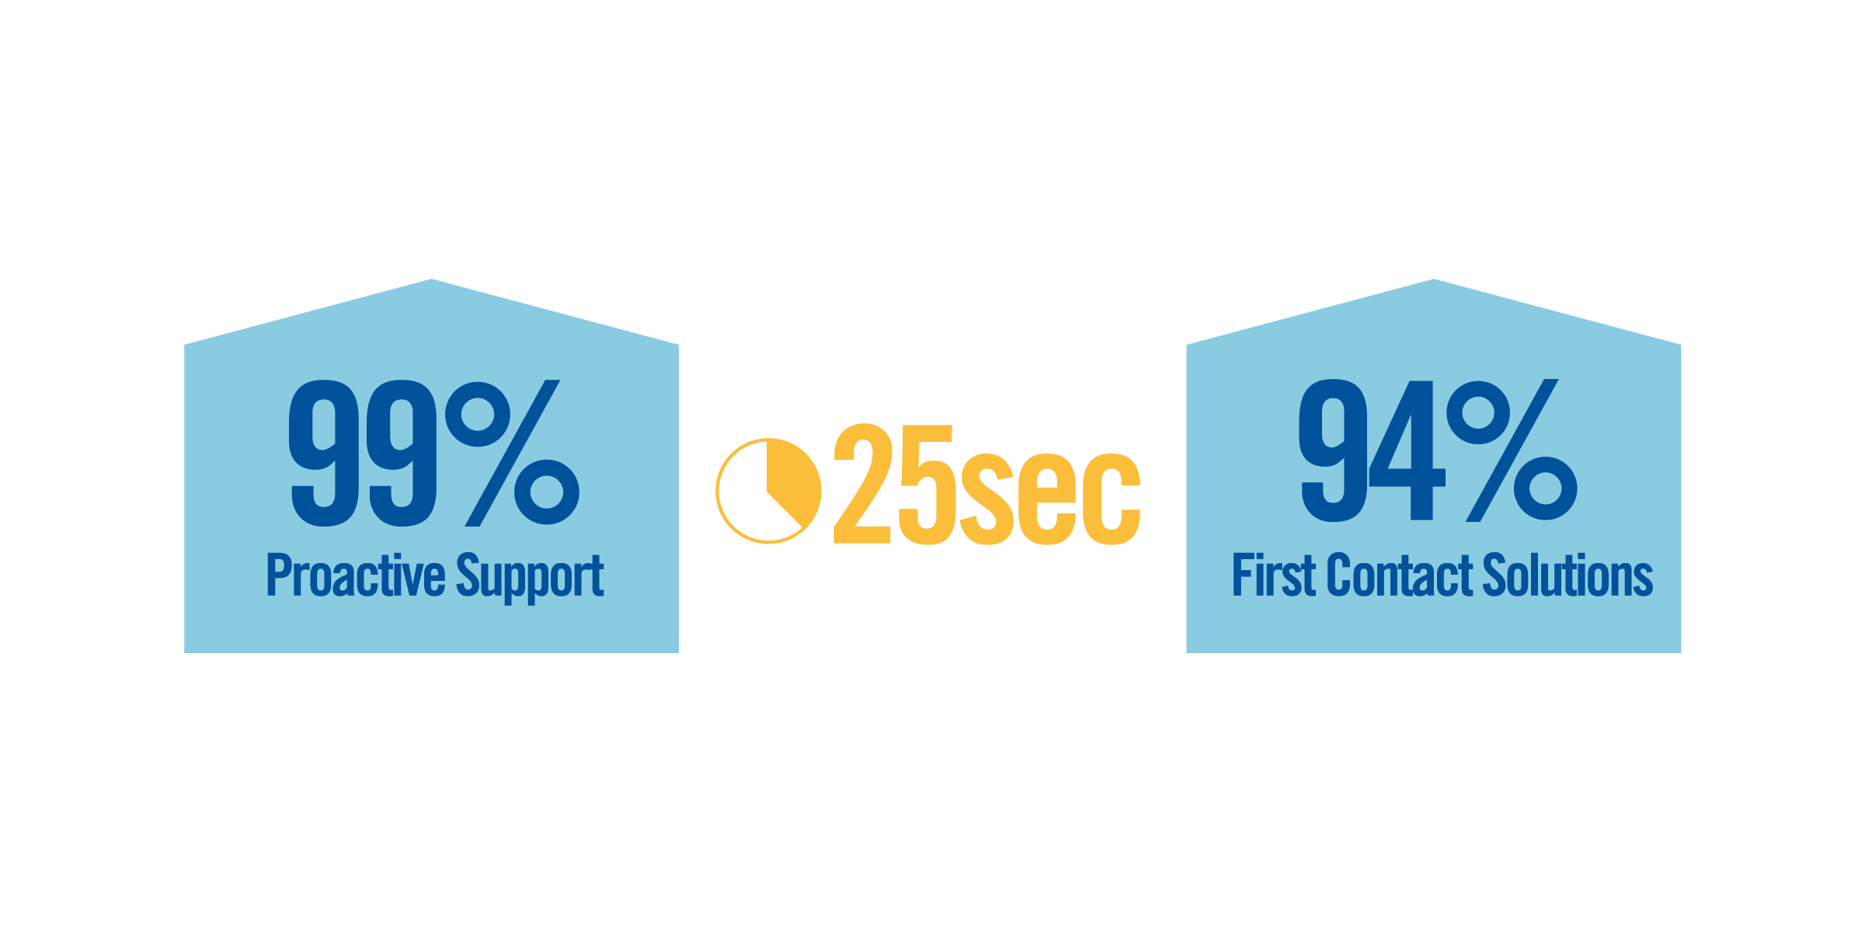
24x7x365
CUSTOMER SUPPORT
Our customer support team will move mountains to keep your services operating at peak performance.
All calls will be answered by a live professional in our USA-based offices with the knowledge and experience to resolve your issue.

Slide 10
ENA TrustCompute Packages
Entry
RAM | Storage | vCPU | IP
40 GB | 1.5 TB | 16 | 4
Network Access Rate 50 Mbps
$700 per Month
Small
RAM | Storage | vCPU | IP
80 GB | 2.5 TB | 32 | 4
Network Access Rate 50 Mbps
$1,200 per Month
Medium
RAM | Storage | vCPU | IP
160 GB | 5 TB | 64 | 8
Network Access Rate 100 Mbps
$2,300 per Month
Large
RAM | Storage | vCPU | IP
320 GB | 10 TB | 128 | 16
Network Access Rate 250 Mbps
$4,400 per Month
X-Large
RAM | Storage | vCPU | IP
640 GB | 20 TB | 256 | 32
Network Access Rate ICB*
$8,500 per Month
Setup & Activation
ENA Internet Access | Setup Fee | Terms
ON-NET | $500 | 12 month commitment
OFF-NET | $2,000 | 12 month commitment

Slide 11
ENA TrustCompute Service Add-ons
ENA TrustCompute packages can be augmented with additional resources from our à la carte menu. Service add-ons will incur an additional monthly recurring charge.
RAM |  |  | Storage |  |  | CPU |  |  | IPs
GB | Price |  | TB | Price |  | Cores | Price |  | IPs | Price
10 | $100 |  | 1 | $50 |  | 8 | $80 |  | 4 | $40
20 | $200 |  | 3 | $150 |  | 16 | $160 |  | 8 | $80
30 | $300 |  | 5 | $250 |  | 32 | $320 |  | 16 | $160
40 | $400 |  | 10 | $500 |  | 64 | $640 |  | 32 | $320
50 | $500 |  | 20 | $1,000 |  | 128 | $1,280 |  | 64 | $640

Slide 12
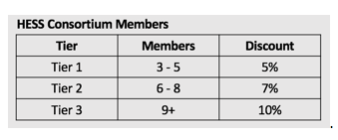
ENA TrustCompute Special Pricing for HESS Members
Standard discount pricing for ENA TrustCompute
10% Discount with a 36-month commitment
Additional discount for HESS members purchasing a Medium package or larger

Slide 13
Additional Cloud Services

Slide 14
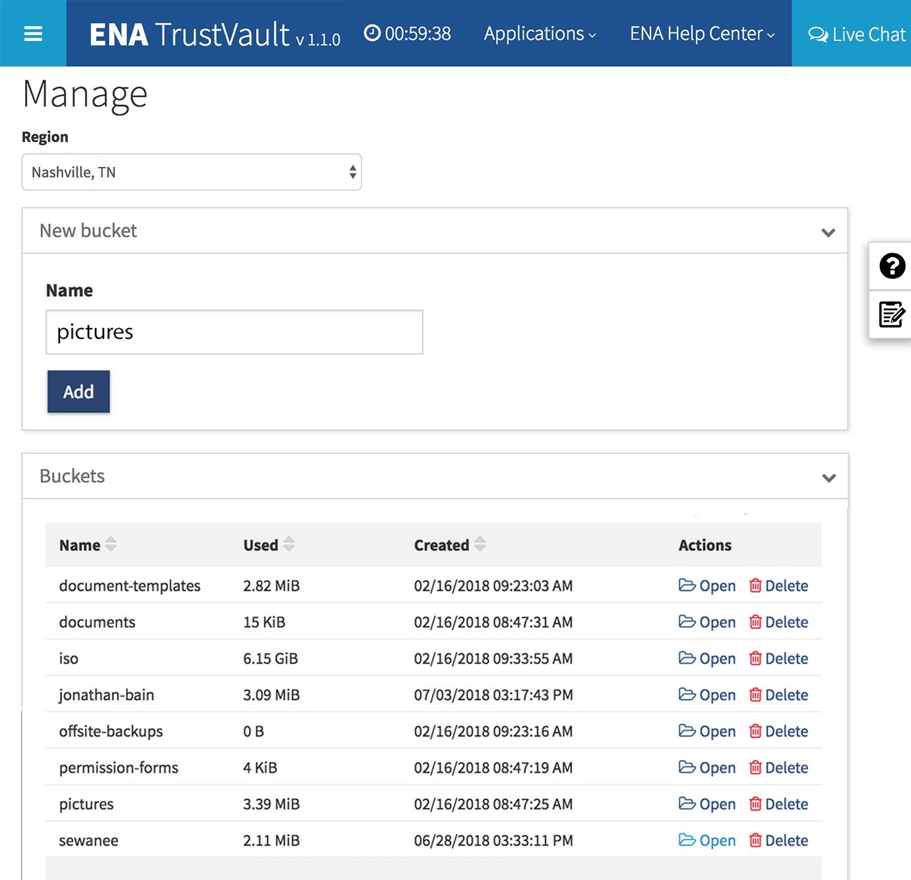
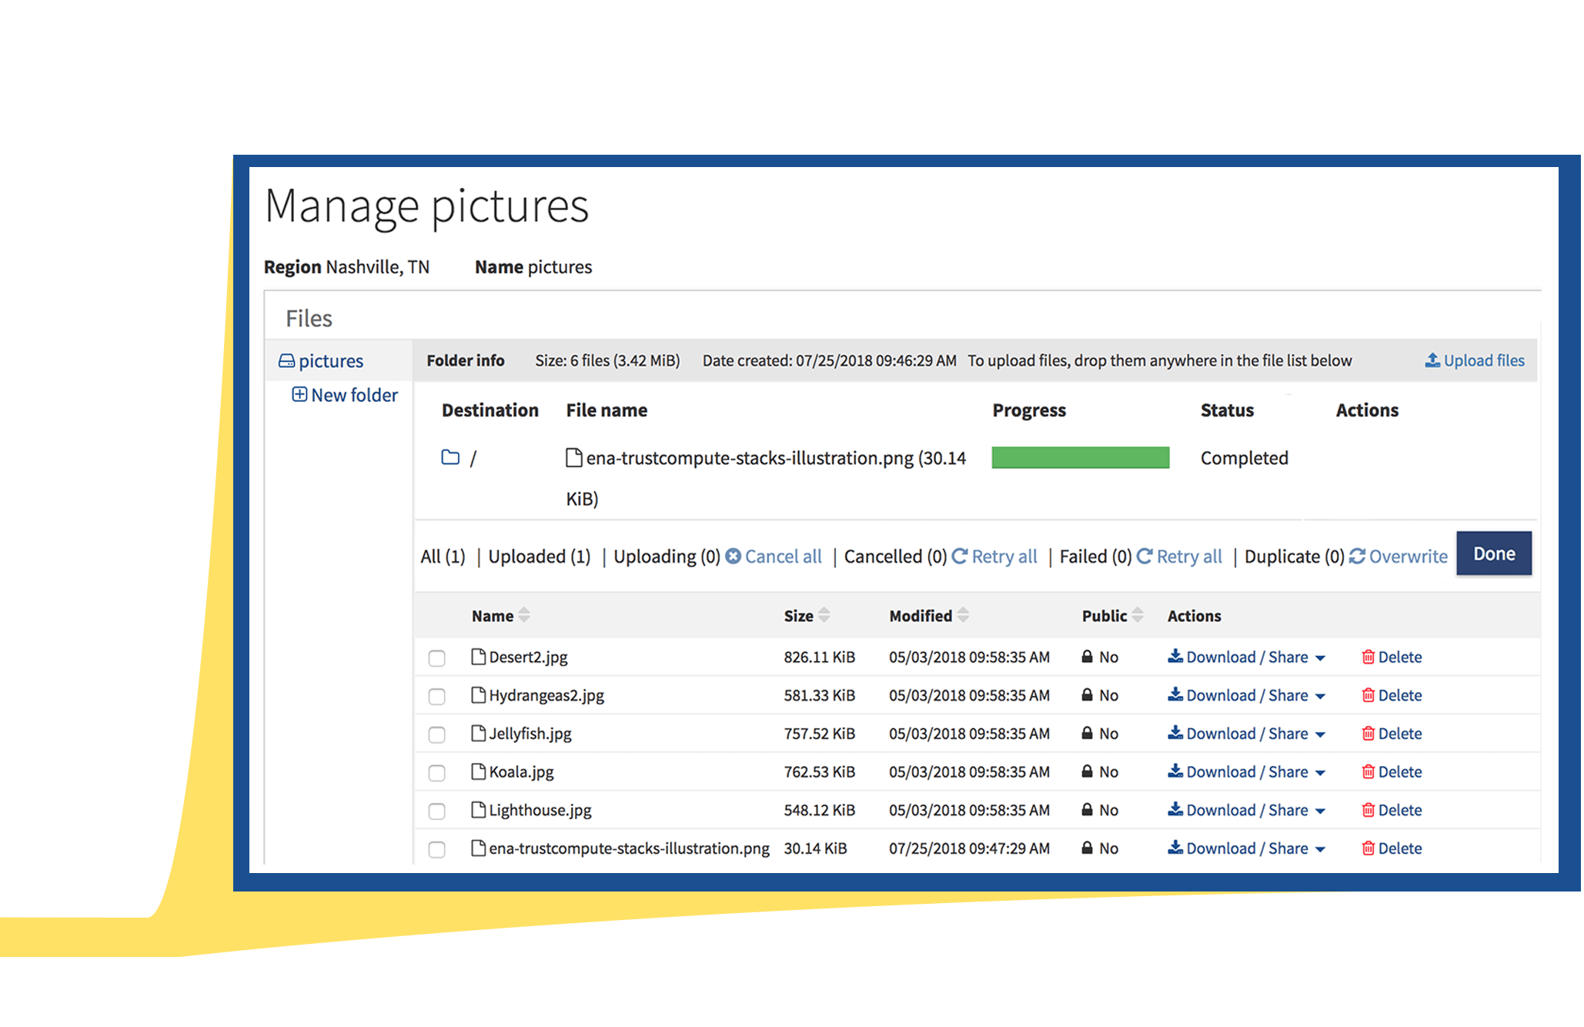
Cloud Storage Service
Feature highlights
Object storage with flat-rate billing
Accessible via an industry standard API or via a web interface with file drag-and-drop capability
File sharing with permissions and expiration control
Secure, scalable, fault-tolerant storage for highest data availability
Perfect for offsite backups and data archives, content hosting, and media streaming
Cost-Effective Cloud Storage
Affordable storage with flat-rate billing makes ENA TrustVault the perfect location for offsite backups, document sharing, document archival, and media hosting.

Slide 15
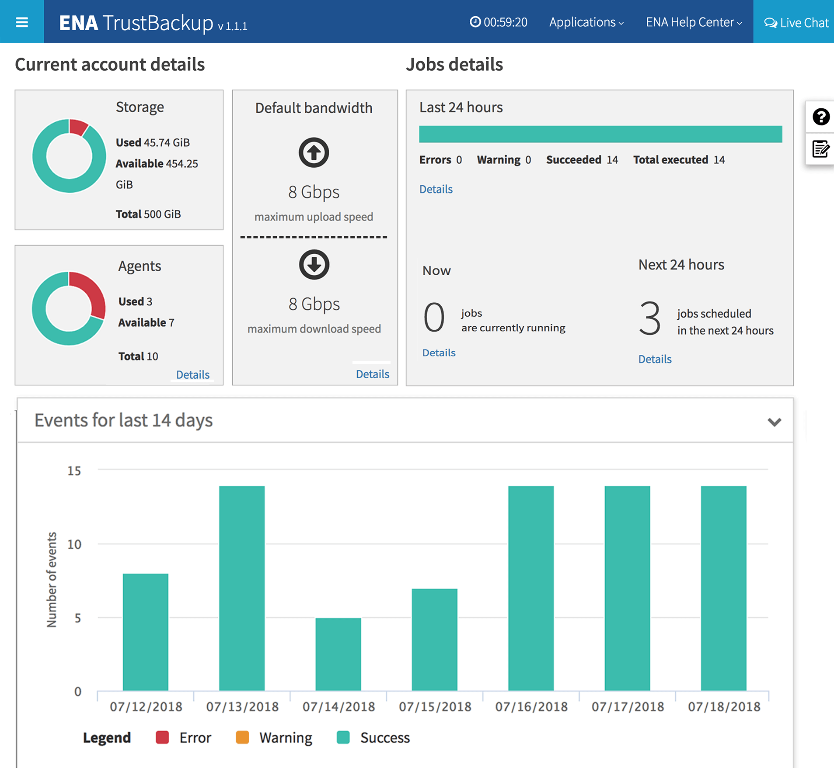
Backup-as-a-Service
Feature highlights
Reliable file backup for servers and workstations
"Forever forward" backup methodology
Secure backup storage in ENA’s cloud
Advanced Encryption Standard (AES)—256 bit data encryption
Web-based interface for backup management and restore activities
Bandwidth policy option to control bandwidth consumption
Secure File Backup
Cost-effective data backup solution that helps organizations protect against data loss caused by operational mishaps or malicious threats such as ransomware.

